Slide 1
Lecture 19
Recursion

Slide 2
Factorial Iteratively
int factorial(int n){
int result = 1;
for(int i=1; i<=n;++i)
{result = result*i;}
return result;
}
int main(){
int x= factorial(0);
cout<<x<<endl;
return 0;
}

Slide 3
Factorial Recursively
int factorial(int n){
if(n<=1)
return n;
else
{return n*factorial(n-1);}
}
int main(){
cout<<factorial(0)<<endl;
return 0;
}

Slide 4
Finding prime numbers using recursion
void findPrime(int i){
if(i>10) return;
bool isPrime = true;
for(int j=2;j<i ;++j)
{
if(i%j == 0)
{isPrime = false;}
}
if(isPrime)
cout<<i<<"is prime"<<endl;
else cout<<i<<"is not prime"<<endl;
findPrime(++i);
}
int main( )
{
findPrime(4);
return 0;
}

Slide 5
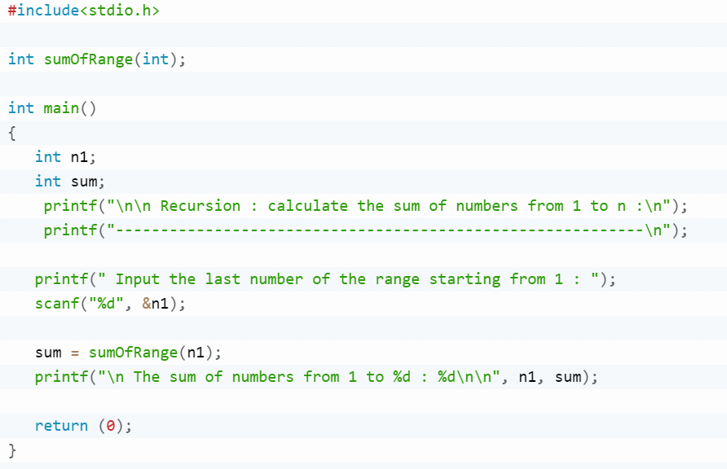
Calculate the sum of numbers from 1 to n using recursive

Slide 6
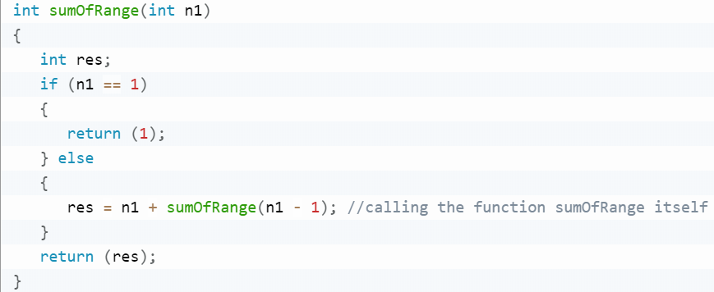
Calculate the sum of numbers from 1 to n using recursive

Slide 7
Binary Search(Find 36)
0 | 1 | 2 | 3 | 4 | 5 | 6 | 7 | 8 | 9
2 | 3 | 5 | 9 | 11 | 14 | 19 | 23 | 33 | 36

Slide 8
Binary Search(Find 36)
0 | 1 | 2 | 3 | 4 | 5 | 6 | 7 | 8 | 9
2 | 3 | 5 | 9 | 11 | 14 | 19 | 23 | 33 | 36

Slide 9
Binary Search(Find 36)
0 | 1 | 2 | 3 | 4 | 5 | 6 | 7 | 8 | 9
2 | 3 | 5 | 9 | 11 | 14 | 19 | 23 | 33 | 36

Slide 10
Binary Search(Find 36)
0 | 1 | 2 | 3 | 4 | 5 | 6 | 7 | 8 | 9
2 | 3 | 5 | 9 | 11 | 14 | 19 | 23 | 33 | 36

Slide 11
Binary Search(Find 36) -- found!!
0 | 1 | 2 | 3 | 4 | 5 | 6 | 7 | 8 | 9
2 | 3 | 5 | 9 | 11 | 14 | 19 | 23 | 33 | 36

Slide 12
Binary Search
bool binarysearch(int key,int array[], int low, int high){
if(low > high) return false;
int mid = (low + high)/2;
if(key == array[mid]) return true;
if(key > array[mid])return binarysearch(key,array,mid+1,high);
else return binarysearch(key,array,low,mid-1);
}...

Slide 13
Binary Search
...
int main(){
//sorted array
int array[10] = {1,3,4,6,7,9,12,34,89,100};
cout<<binarysearch(6,array,0,9)<<endl;
return 0;
}

